Slide 1
Seng 275 software testing dr. navneet kaur popli

Slide 2
Selenium ide Automated web ui testing

Slide 3
Selenium IDE extension for chrome
Download selenium ide extension for chrome/firefox.
Record a new test case in a new project
DemoSelProject
Give url for only testing blog website
http://only-testing-blog.blogspot.com/2014/01/textbox.html

Slide 4
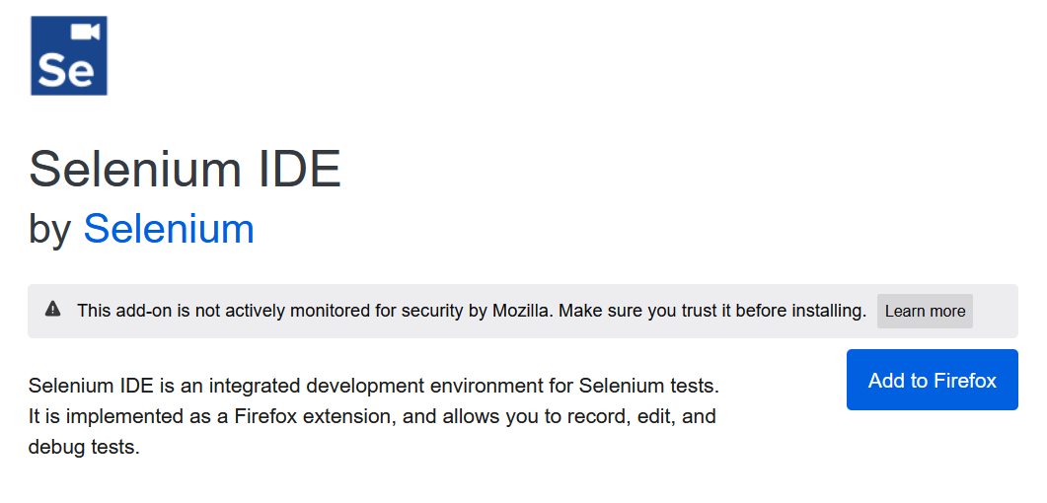

Download Selenium IDE for Firefox
This icon is then added to your browser

Slide 5
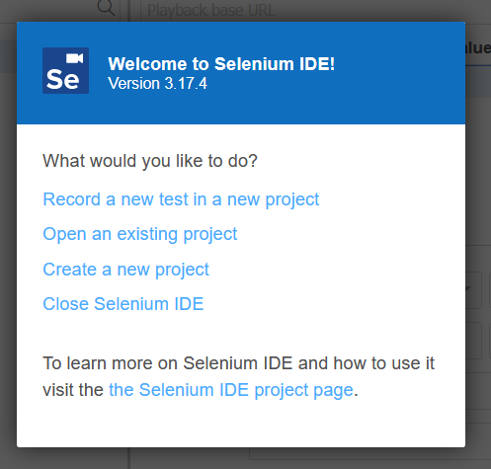


Go to browser> click on Selenium plugin

Slide 6
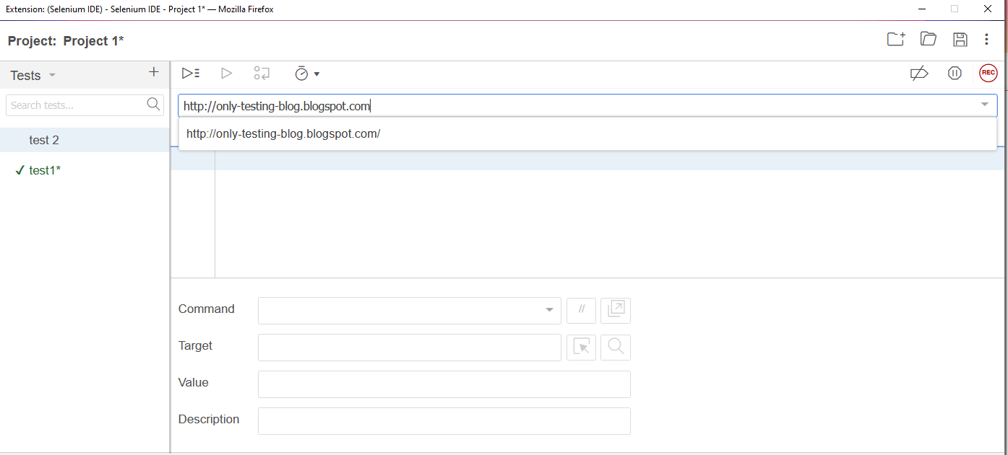
Write project name and base URL for the webpage to be tested.

Slide 7
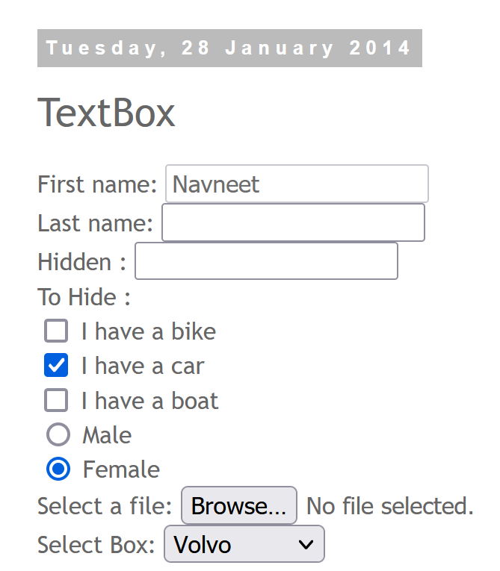
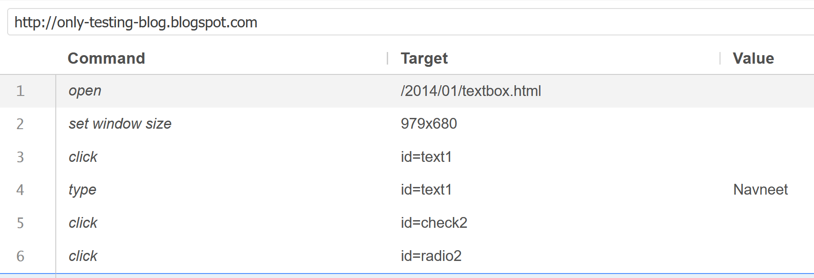
Start recording

Slide 8
Perform some actions on the web page
Give Name, select ‘I have a car’ and Female.
Go to Selenium IDE again and press ‘Stop Recording’.
The entire test with all the actions you performed is created for you.
You can playback that test too.

Slide 9
Assert title test

Slide 10
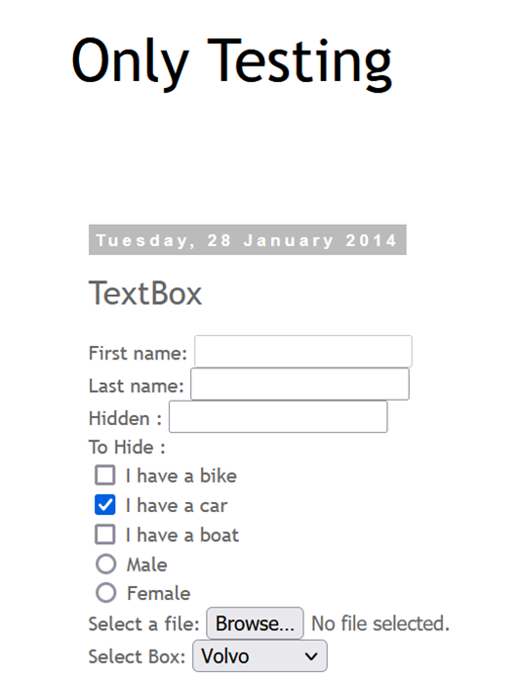
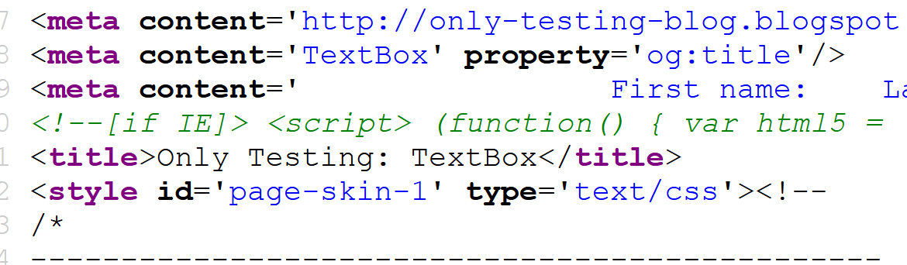

assert title command
Check whether the expected title is displayed. Go to ‘View Page Source’ by right clicking on the page.

Slide 11
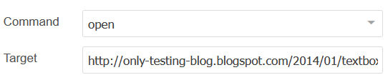
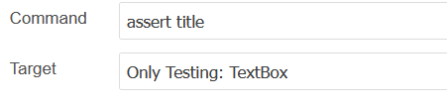
Give ‘open’ command and then ‘assert title command’

Slide 12
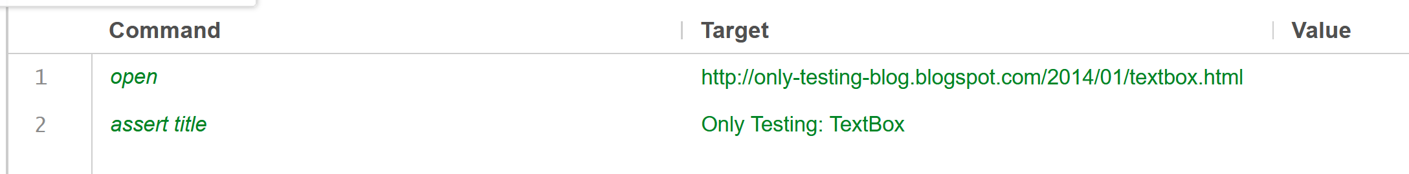
assert title command
Check whether the expected title is displayed. Go to ‘View Page Source’ by right clicking on the page.
Green color indicates test has passed

Slide 13
Assert title for this web page
http://automationpractice.com/index.php

Slide 14
Assert and verify text

Slide 15
assertText, verifyText
assertText and verifyText both get the text of an element (as defined by the locator) and check if it meets the requirement of the pattern.
This works for any element that contains text.
Assert and verify commands are both useful for verifying condition match or not.
The difference is that verify command will verify the condition and if it does not match, it will only show an error message in log area and the macro continues to run.
With the assert command, if the condition does not match then it will stop remaining macro execution in the selenium IDE software testing tools.

Slide 16

Assert text and Verify text for ‘Show Me Confirmation’ button.
assert text

Slide 17
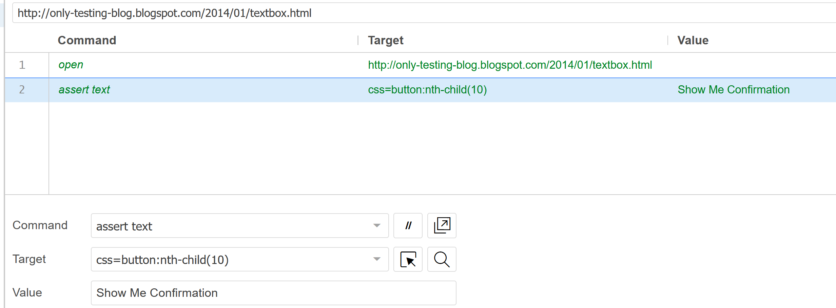



Test Passes
Select target in page
css=button may also work here.

Slide 18
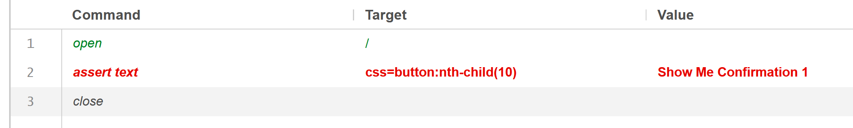
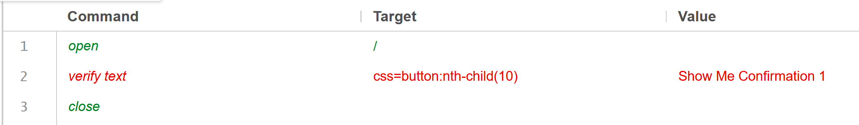
Assert vs verify

Slide 19

Assert and verify text http://automationpractice.com/index.php

Slide 20
Verify element not present

Slide 21
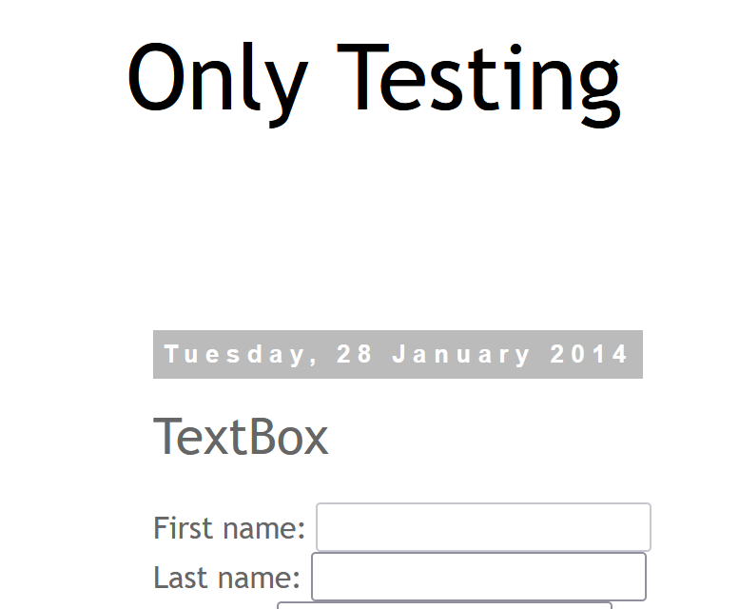
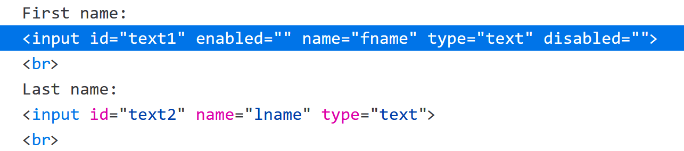
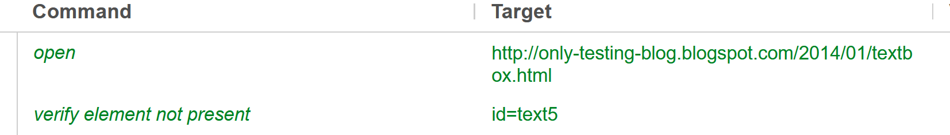
Verify element not present- http://only-testing-blog.blogspot.com/2014/01/textbox.html

Slide 22
Assert vs verify
Assertions (hard assertions) state confidently that application behavior is working as expected.
In a hard assertion, when the assertion fails, it terminates or aborts the test.
If the tester does not want to terminate the script, they cannot use hard assertions.
To overcome this, one can use soft assertions, Verify.

Slide 23
Verify element is present in the same webpage for text1

Slide 24
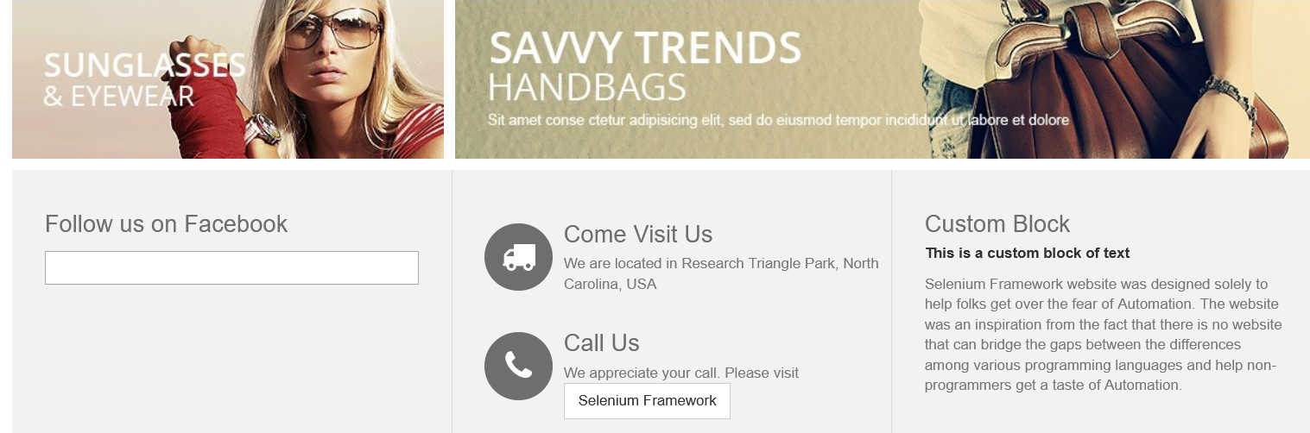
http://automationpractice.com/index.php verify element is present

Slide 25
Assert selected label

Slide 26
assert selected label
The purpose of assert selected label command in Selenium IDE, is to check whether the given option is selected in the dropdown field using its label text or display text.
In ‘Only testing’ web page, from ‘Select Box’, we will first select ‘Opel’ and then verify our selection.

Slide 27
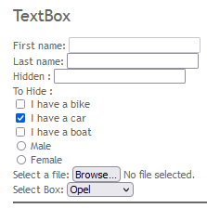
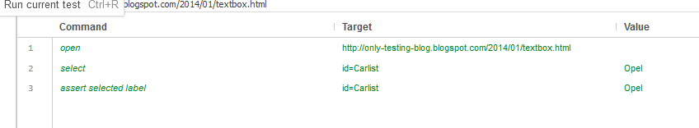
Assert selected label http://only-testing-blog.blogspot.com/2014/01/textbox.html

Slide 28
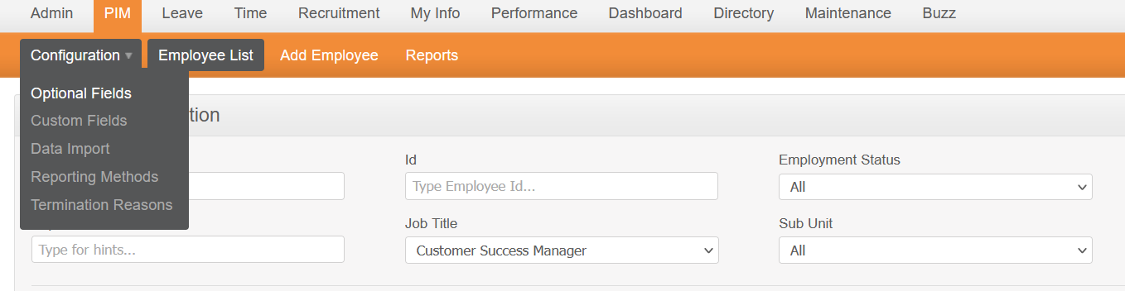
Assert selected item
https://opensource-demo.orangehrmlive.com/index.php/pim/viewEmployeeList

Slide 29
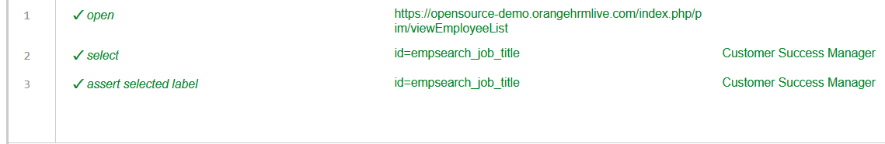
Solution

Slide 30
Dialogue boxes Alert/ confirm/ prompt (asserting the content of the messages when these buttons are clicked)

Slide 31
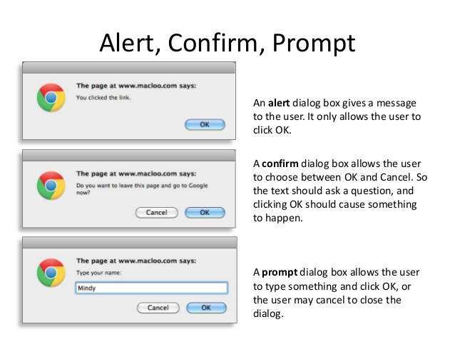
Ref: https://www.slideshare.net/macloo/javascript-101-16754994

Slide 32
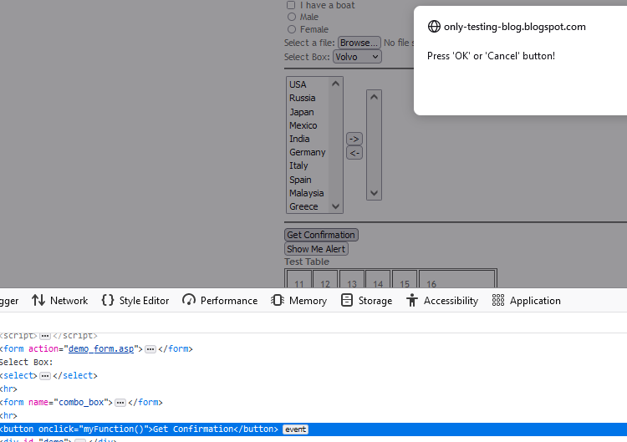
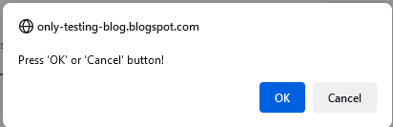
assert confirmation
“assert confirmation" command will retrieve the confirmation message text and compare it with targeted text.

Slide 33
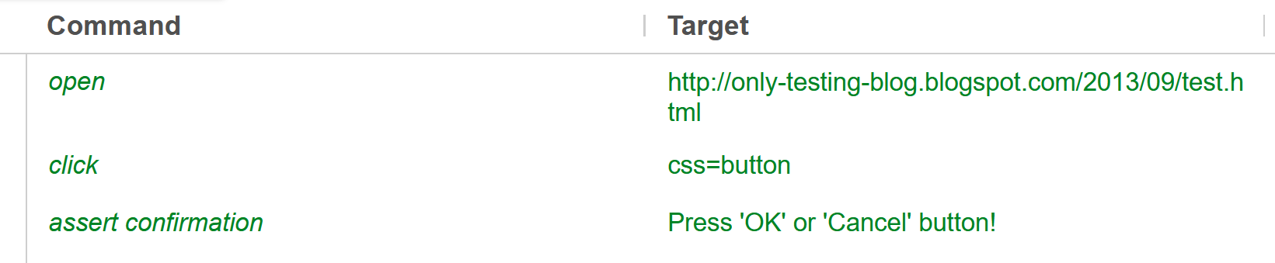



Slide 34
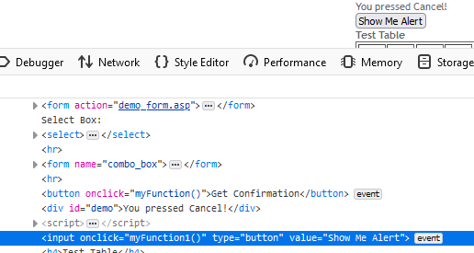
Assert alert

Slide 35
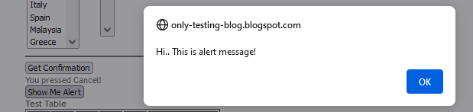
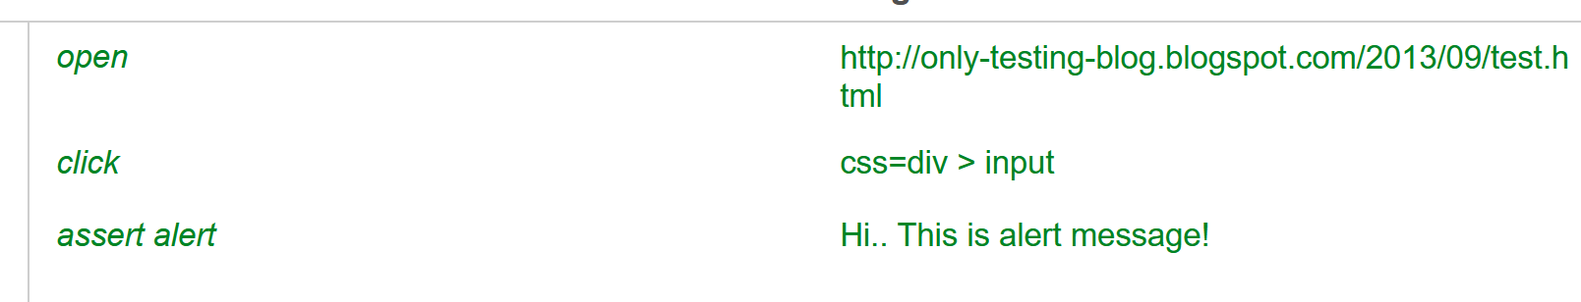

Slide 36
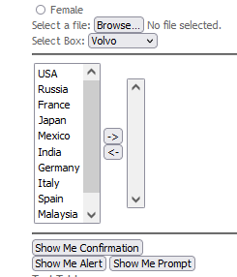
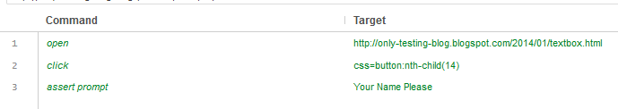
Assert prompt

Slide 37
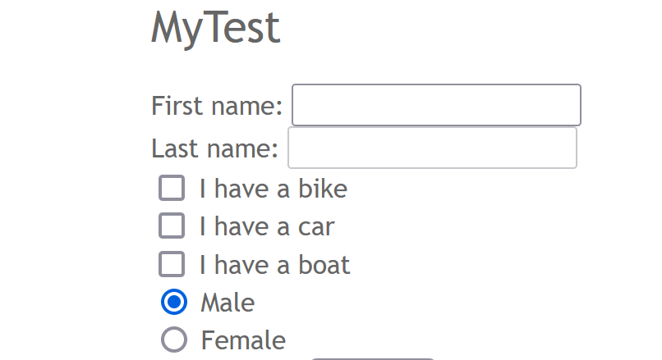
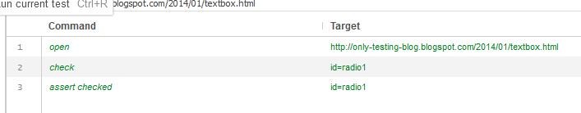
Assert checked- Verifying whether One of the Radio buttons checked or not checked

Slide 38
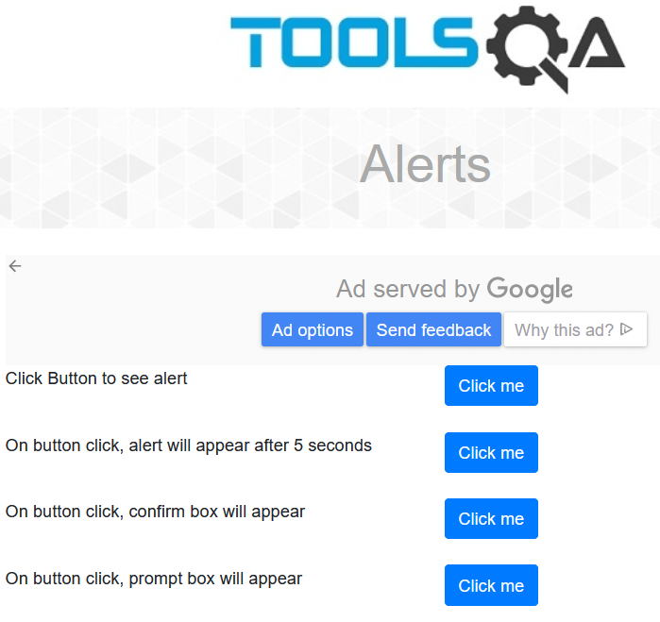
https://demoqa.com/alerts

Slide 39
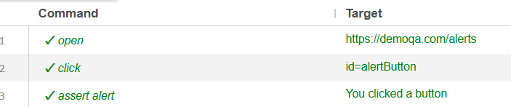
Assert alert

Slide 40
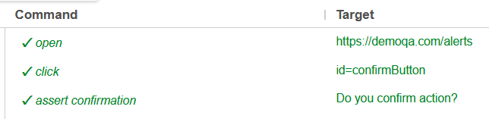
Assert Confirmation

Slide 41
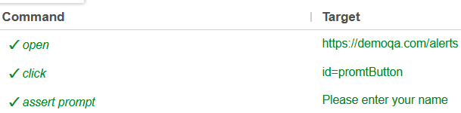
Assert prompt

Slide 42
Assert checked for checkboxes

Slide 43
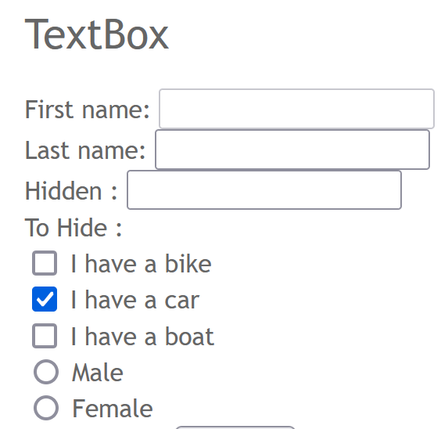
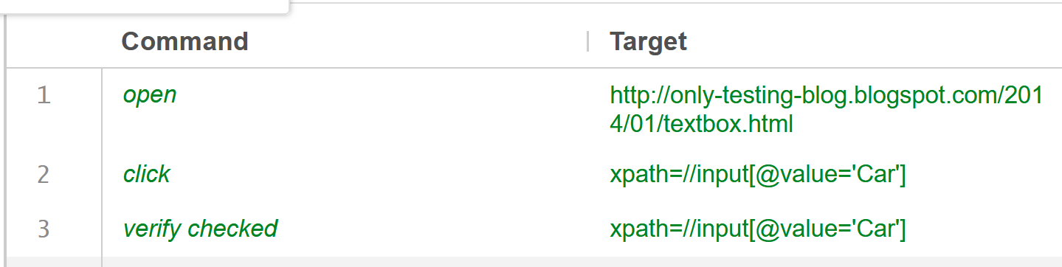
Verify checked- Verifying whether a particular check box is checked or not http://only-testing-blog.blogspot.com/2014/01/textbox.html

Slide 44
Other alternative commands
‘check’ can work in place of ‘click’.
‘assert checked’ can also work in place of ‘verify checked’.

Slide 45
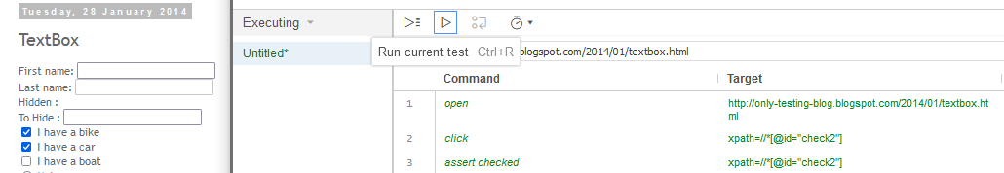
Bike will automatically be clicked because
‘Check’ is also going to work here
Id=‘check2’ is also going to work here

Slide 46
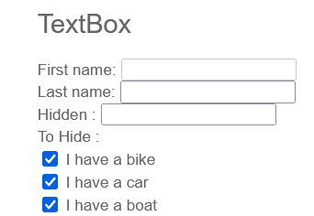
Multiple checks
Check all three options and assert all three are checked.
In this website, checkbox, ‘I have a bike’ is checked by default.

Slide 47
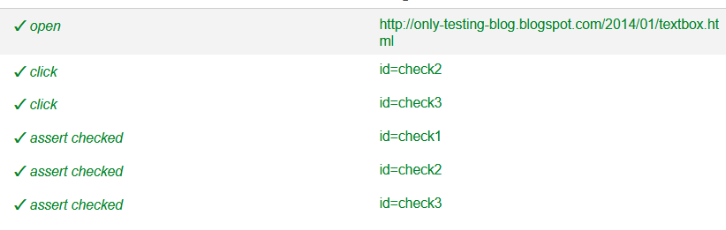
Test

Slide 48
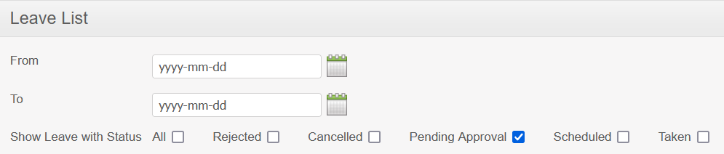
https://opensource-demo.orangehrmlive.com/index.php/leave/viewLeaveList
Pending approval is already selected
Click ‘Rejected’ and ‘Cancelled’
Assert the selection

Slide 49
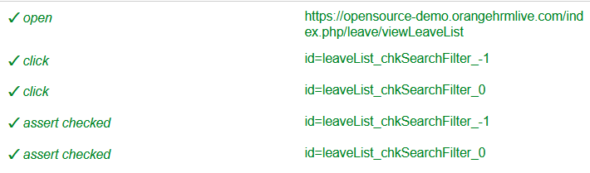
Solution

Slide 50
Assert value

Slide 51
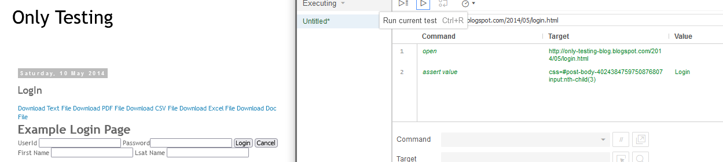
Assert value
http://only-testing-blog.blogspot.com/2014/05/login.html
The purpose of assert value command in Selenium IDE, is to check that the value attribute value of the given UI element.

Slide 52
Can you assert value for the ‘Cancel’ button?

Slide 53
Assert editable

Slide 54
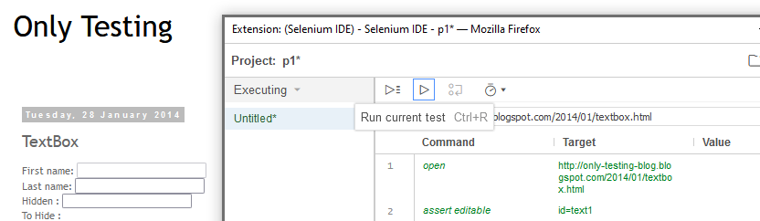
Assert editable http://only-testing-blog.blogspot.com/2014/01/textbox.html
The purpose of assert editable command in Selenium IDE, is to check whether the given field is in an editable state.

Slide 55
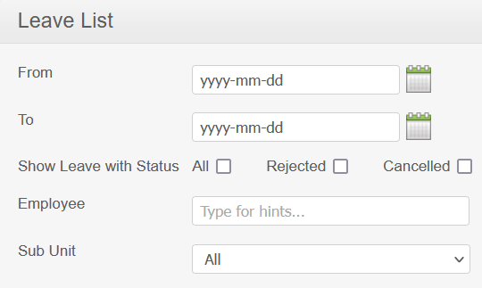
Check whether Employee text box is editable or not

Slide 56

Solution

Slide 57
Another demo website
Actitime
Create a free account here and start testing
https://online.actitime.com/npopli/tasks/tasklist.do
Good for assignments too
krn informaix-youtube videos

